Slide 1

BRINDAVAN
INSTITUTE OF TECHNOLOGY AND SCIENCE(BITS-KNL)
(Affiliated to JNTUA,A.P)
NH-7,PEDDATEKUR,KURNOOL-518218
DEPARTMENT OF COMPUTER SCIENCE & ENGINEERING
A Project Review on
INNOVATIVE CONTACTLESS DOORBELL USING IOT INTEGRATION
Presented by
TEAM NAME:BABES GOT BYTE’S
Team Member Names: Roll Numbers:
K.Raja Kumar (212N1A0551)
P.Tharun Kumar (212N1A0557)
S.Khaja Hussain (212N1A0569)
S.Sadiq (212N1A0575)
S.Naveed Ahmed (222N5A0504)
Project Guide:
K.Raju

Slide 2
Contents:
Introduction
Abstract
Existing System
Proposed System
Key Features
Software and hardware Requirements
Module
a)Importance of innovative Contactless doorbell
b)Working Principle
c)Alarm System
Architecture
Flowchart
UML diagram
Source code
Screenshots
Applications
Advantages
Future scope
conclusion

Slide 3
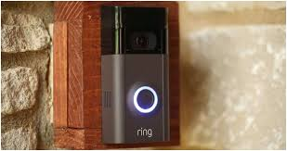
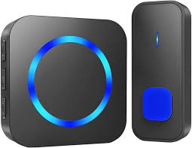
INTRODUCTION
Welcome to the world of secured contactless doorbell. An innovative contactless doorbell using IOT integration is an innovative solution that allows visitors to allow their presence without touching the doorbell physically.
What is contactless Doorbell ?
A contactless doorbell is a device that uses sensors and wireless communication technologies to detect a visitors presence and alert the home owner without requiring physical contact.

Slide 4
ABSTRACT
The "Design and Implementation of Secured Contactless Doorbell using IoT" is a smart and secure solution designed to enhance the traditional doorbell system.
This project incorporates Internet of Things (IoT) technology, integrating an IR sensor to detect proximity and a buzzer for audio alerting.
When someone approaches the door, the IR sensor detects their presence, activating the buzzer inside the house.
This contactless doorbell improves security and provides a modern, hands free alternative for visitors

Slide 5
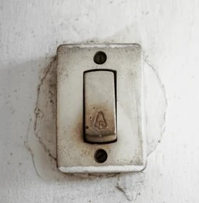
EXISTING SYSTEM
The existing Conventional doorbell systems may lack the ability to alert residents without physical interaction, potentially compromising security.
These conventional doorbells are unhygienic and feel inconvenience for the visitors.
Traditional doorbells.
Contact with the doorbell.
unhygienic doorbells.
Without physical interaction this doorbells do not
work.

Slide 6
PROPOSED SYSTEM
The proposed Secured Contactless Doorbell uses an IR sensor to detect the presence of someone near the door.
When the sensor is triggered, indicating someone is near the door, a buzzer inside the house is activated and gives alert the residents.
This contactless system provides a secure and convenient way for visitors to announce their presence without physical contact with the doorbell.
secure and convenient way.
Infrared Motion Detection.
Smart home integration.
Gesture based technology.

Slide 7
KEY FEATURES
IR Sensor:
Detects proximity of individuals near the door.
Buzzer:
Activates to produce an audible alert inside the house.
Secure and Contactless:
Enhances security and eliminates the need for physical contact.
Adjustable Sensitivity:
Allows customization of sensor sensitivity for different door environments.

Slide 8

SOFTWARE AND HARDWARE COMPONENTS
Hardware Tools:
IOT Recuirements:
Microcontroller (e.g., Esp8266/Node MCU )
IR Sensor
Buzzer
Power Source (5v,3.3v)
System Requirements:
Hard disk
RAM
Processor
Software Tools:
Arduino IDE(integrated development environment)

Slide 9
Hardware Components
ESP8266/Node MCU:
Node MCU is an open-source firmware and development kit that helps you to prototype or build IoT products. It includes firmware that runs on the ESP8266 Wi-Fi SoC from Express if Systems, and hardware which is based on the ESP8266 module.
IR Sensor:
An IR sensor is the device that detects and measures infrared radiation which is a type of electromagnetic radiation

Slide 10
Alarm System:
A buzzer or beeper is an audio signaling device, which may be mechanical or electromechanical. Typical uses of buzzers and beepers include alarm devices, timers, train and confirmation of user input such as a mouse click or keystroke.
Power Supply :
3.3V Pin :
The ESP8266 operates on 3.3V, and you can directly supply 3.3V to its VCC pin. Ensure that the power source is well-regulated, as the ESP8266 can be sensitive to fluctuations.
Direct 5V is not safe :
Do not connect 5V directly to the ESP8266 VCC pin, as this can damage the chip.

Slide 11
a)IMPORTANCE OF INNOVATIVE CONTACTLESS DOORBELL
MODULE
Increased Security:
Many contactless doorbells are equipped with high-definition cameras and motion detectors. This provides a live video feed, recording capabilities, and even facial recognition, which can enhance home security and help identify visitors.
Smart Home Integration:
Contactless doorbells can often integrate with other smart home systems, such as voice assistants (like Amazon Alexa or Google Assistant) and smart locks. This can create a more seamless and automated home experience.
Customization and Control:
Many contactless doorbells offer customizable settings, such as adjustable motion sensitivity, customizable chimes, and integration with home security systems. This level of control allows homeowners to tailor the system to their specific needs.

Slide 12
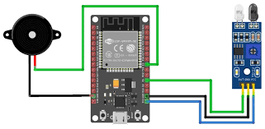
b) WORKING PRINCIPLE
IR sensor detect the presence of motion of object near the door and send the signals to the ESP8266.
An IR sensor is the device that detects and measures infrared radiation which is a type of electromagnetic radiation.
The ESP8266 processes these signals and activates the alarm system i.e buzzer if any object is detected near the IR sensor.
By this the contactless doorbell alerts the home owners.

Slide 13
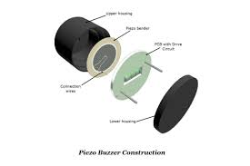
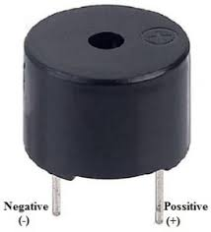
c) ALARM SYSTEM (BUZZER)
The Alarm can be integrated with other smart devices for remote notifications.
Prompt evacuation and ventilation are recommended upon hearing the alarm.
In the event of an object detection, the system triggers a loud alarm to alert Homeowners.

Slide 14
ARCHITECTURE
IR sensor
If motion is detected
Buzzer is on
ESP8266
If motion is not detected
Buzzer is off
Buzzer
Power supply

Slide 15
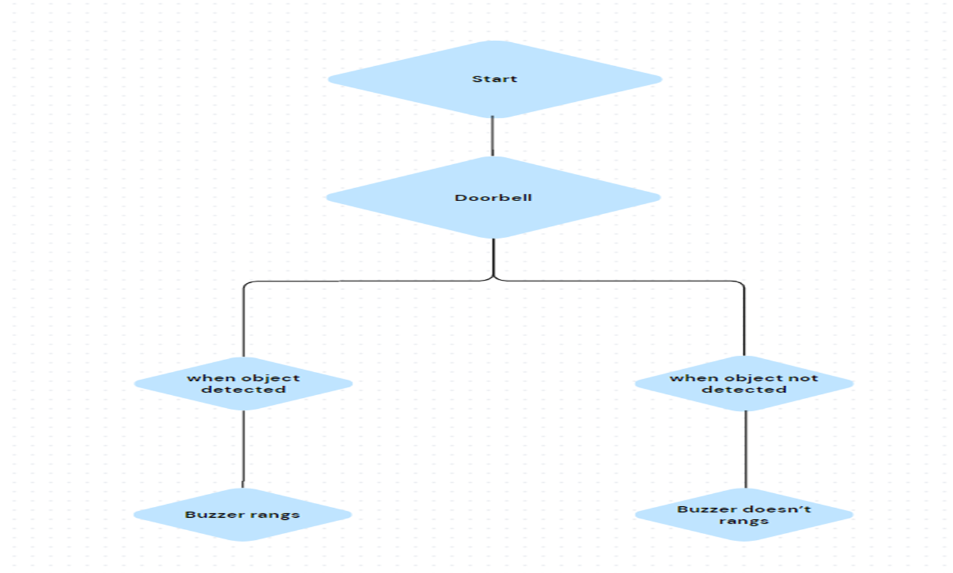
FLOWCHART

Slide 16
UML DIAGRAM
ESP8266
IR Sensor
PC
Buzzer

Slide 17
SOURCE CODE
const int irSensorPin =D2;
const int buzzer =D3;
void setup()
{
pinMode(irSensorPin, INPUT);
pinMode(buzzer, OUTPUT);
Serial.begin(9600);
}
void loop()
{
int irValue = digitalRead(irSensorPin);
if (irValue == LOW)

Slide 18
{
Serial.println("Object detected. Ringing the doorbell.");
digitalWrite(buzzer, HIGH); // Activate the relay (doorbell)
delay(1000); // Wait for 1 second
}
else
{
Serial.println("No object detected.");
digitalWrite(buzzer,LOW);
delay(1000);
}
}

Slide 19
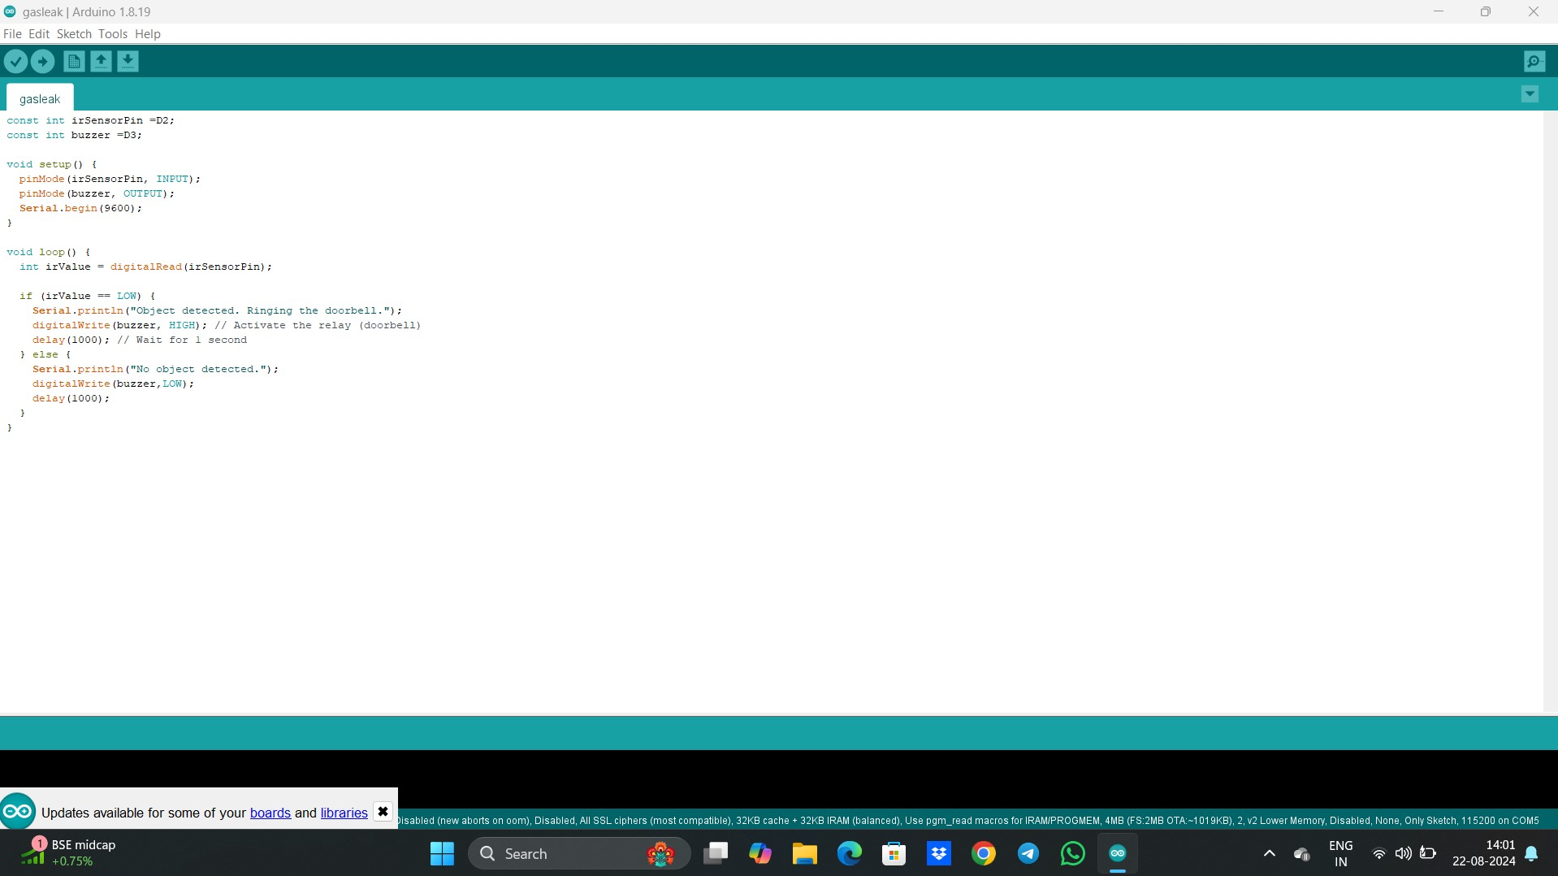
SCREENSHOTS
Code is inserted into the Esp8266 using Arduino IDE.

Slide 20

If the object is detected near the door then doorbell rangs(BUZZER)
If the object is not detected near the door then doorbell not rangs(BUZZER)

Slide 21
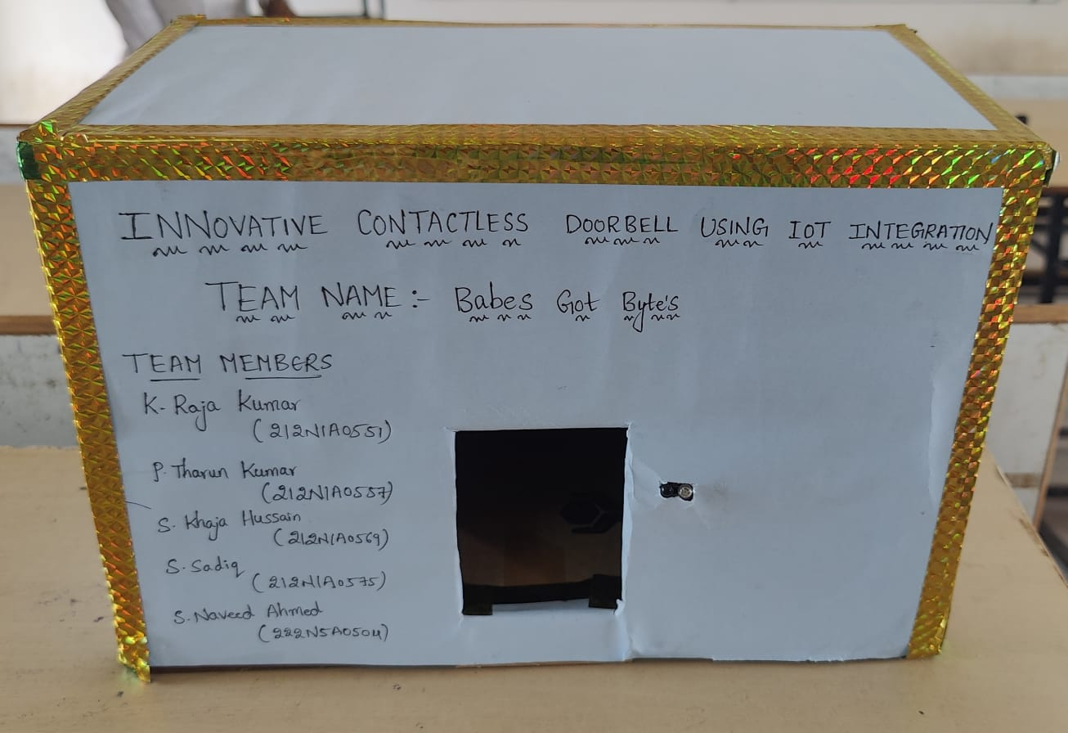
Model representation of innovative contactless doorbell using IOT integration

Slide 22
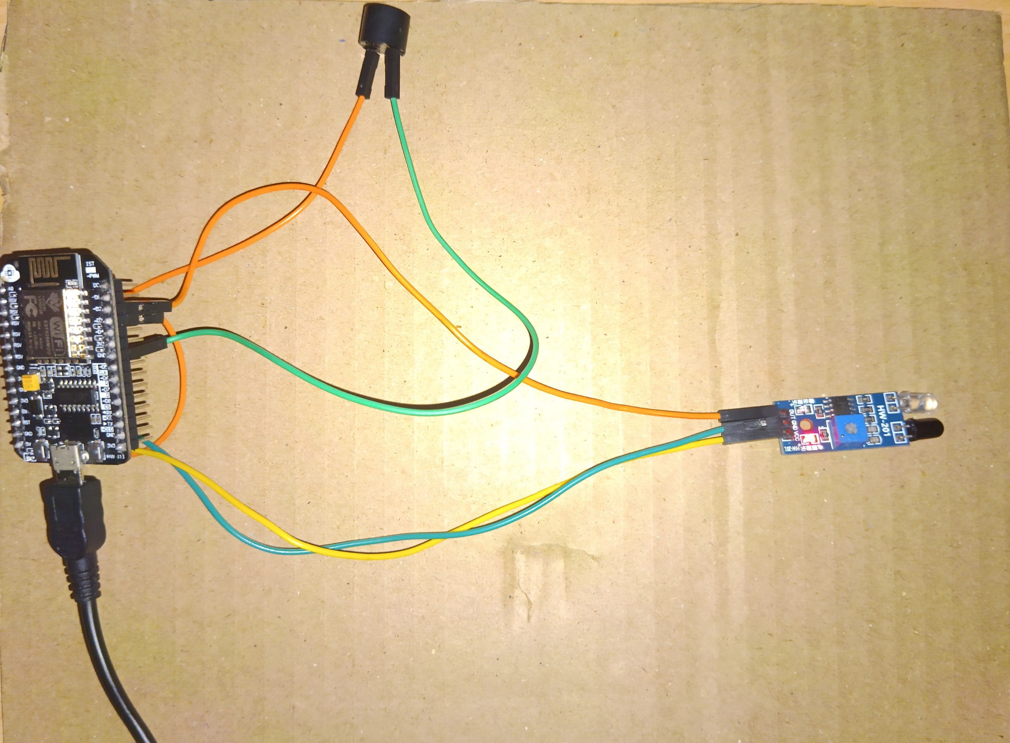

Slide 23
CONNECTIONS
IR Sensor to ESP-8266:
Connect the Vcc pin of the IR sensor to the 3V3 pin of the ESP-8266 board.
Connect the GND pin of the IR sensor to the GND pin of the ESP-8266 board.
Connect the OUT pin of the IR sensor to the D2 pin of the ESP-8266 board.
Buzzer to ESP-8266:
Connect the +VE pin of the Buzzer to D3 pin of the ESP-8266 board.
Connect the –VE pin of the Buzzer to GND pin of the ESP-8266 board.

Slide 24
APPLICATIONS
Residential Buildings
Health and Hygiene
Commercial Buildings
Public Buildings
Educational Institution
Energy Efficiency
Safety
Security

Slide 25
ADVANTAGES
Advantages:
Enhanced Security
Smart Home Integration
Convenience and User friendly
Health and Hygiene
Enhanced User Experience
Contactless Operation
Cost Efficient

Slide 26
FUTURE SCOPE
The Future scope of innovative contactless doorbell using IOT integration has opened up with Enhanced security and improved functionality.
Here are some potential future developments:
Facial recognition.
Biometric Authentication.
Voice Commands.
Event recording.
Notification and alerts to the mobiles.

Slide 27
CONCLUSION
Overall, the conclusion of an Innovative Contactless Doorbell using IOT Integration would aim to provide a comprehensive assessment of its performance and potential benefits, helping users make informed decisions about its implementation and use.
Some key points that might be included in the conclusion are:
Scalability
Market Potential
Impact on Daily life
Data security and Privacy
User Experience
Cost Effectiveness

Slide 28
REFERENCE
[11] Wikipedia. (2021, June 20). Doorbell.
https://en.wikipedia.org/wiki/Doorbell
[18] J. R P, J. Inunanuel, J. M, B. M, L. N. K and R. S.
Krishnan, "Wi-Fi Based Touchless Bell Ringing System for
Temples," 2022 6th International Conference on Electronics,
Communication and Aerospace Technology, Coimbatore, India,
2022, pp. 226-229, doi:
10.1109/ICECA55336.2022.10009101.
[12] Ursan, R. (2020). Contactless doorbell. Hackster.Io. Retrieved October 22, 2021, from https://www.hackster.io/robert ursan/contactless-doorbell-143390
[13] G. K. S, R. Priyadarshi, A. Kumar and W. Tasnin,
"Cost-Effective Touch-less Doorbell to Combat COVID-19," 2021 Innovations in Power and Advanced Computing
Technologies (i-PACT), Kuala Lumpur, Malaysia, 2021, pp. 1-7, doi: 10.1109/i-PACT52855.2021.9696966.
[14] A. Sharma, D Kumar, VC Sati, “An IoT Enabled Smart Doorway Security System”,
https://www.brcmcet.edu.in/downloads/files/n61bdb5ca83452.pdf\
[15] Abhishek Gudipalli, Vaibhav Kejriwal, Vaishnavi Patel, Riddhi Gupta and Utkarsh Dixit, “Covid Bell – A smart doorbell
solution for prevention of Covid-19”, https://doi.org/10.1515/pjbr-2022-0115
[16] MA Sharma, V Kumar, MV Verma, “Design & Development of an IoT System to Enable User to Remotely Monitor
and Control Doorway Access”, https://d1wqtxts1xzle7.cloudfront.net/73378349/IRJET_V8I 10105-
libre.pdf?1634901281=&response-content- disposition=inline%3B+filename%3DIRJET_Design_and_D
evelopment_of_an_IoT_S.pdf&Expires=1696691764&Signa ture=PD5A7G97sHmPhh2hYj0SsEn6YEsuNf84mpzoYQLS3eDn-E26Yypm~xTSiQqg4XELWZGCfgV- qVK4zr9eFtXjpvxqz0oidy22HCC8n2HRNKT0BSaR3ECC
R3RyOAUugrr0eoN0AjxL7wbwzGmWy7~NIZR01LVGiK bVkPqZj0Err3-9ZjAWhDR3aeQeXDv0m~UZrDc11BuZ3dsYzCU4e~75huwavg GKQAO~lZfWjKeLHd9OYKlp6ijsNKAFtMJSSLE6h7BXr
TeY78DIf4hjiWJAM5yoRHCIwWv~-yEj~ipQJv- uSZCFODfjO2x~-
ULjeD0xOm0Kd9zNrzqpMmBgwvgw &Key-Pair-Id=APKAJLOHF5GGSLRBV4ZA
[17] A. Mosenia and N. K. Jha, "A Comprehensive Study of Security of Internet-of-Things," in IEEE Transactions on Emerging
Topics in Computing, vol. 5, no. 4, pp. 586-602, 1 Oct.-Dec. 2017, doi: 10.1109/TETC.2016.2606384.

Slide 29
THANK YOU!

